Slide 1
Python: Object Oriented Programming
Programming for Analytics: MPBA G507
Dr. Revendranath T
12-Nov-2021

Slide 2
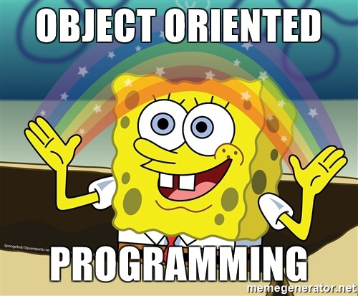

Slide 3
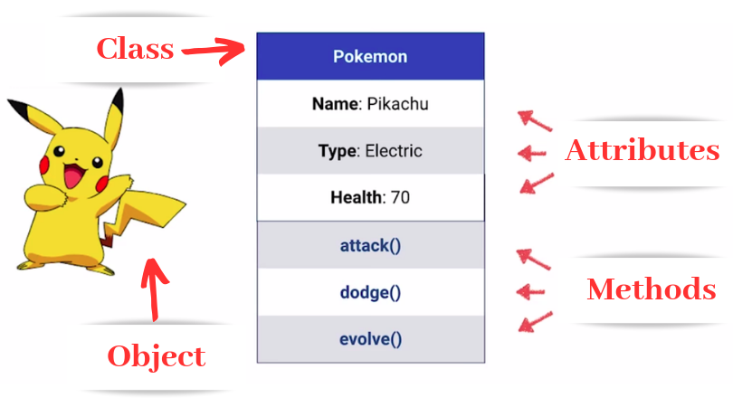
Class Example: Pokemon

Slide 4
Object Oriented Programming (OOP)
Two components
Class
Objects
Class is a blueprint
A structure that business wants
Object is an instance of class with real values
Special Note:
__init__ is a special method in Python classes that are executed when a class object is instantiated
Attributes in self parameters are accessible across the classes in Python

Slide 5
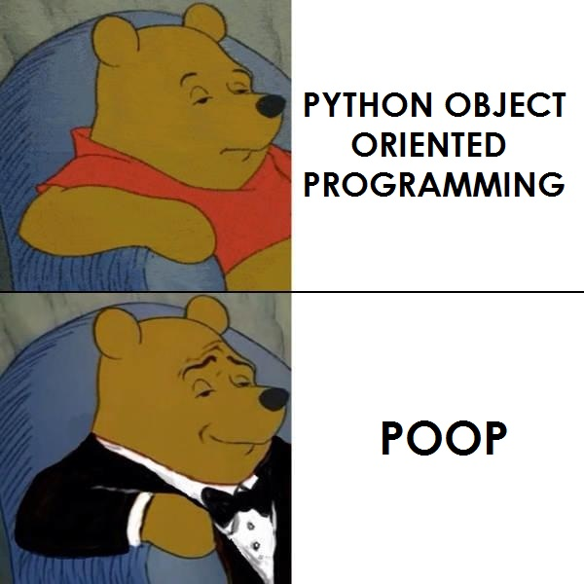

Slide 6
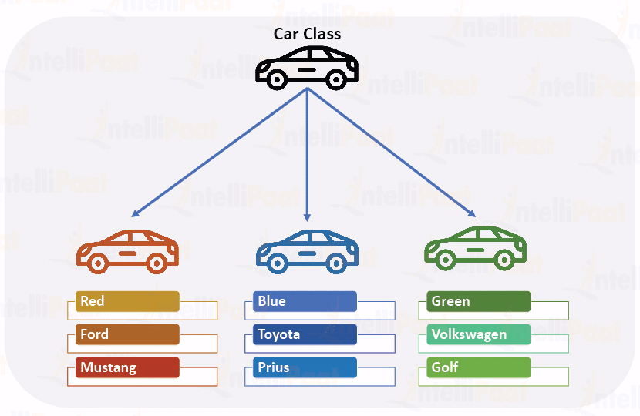
Think in Classes: Car

Slide 7
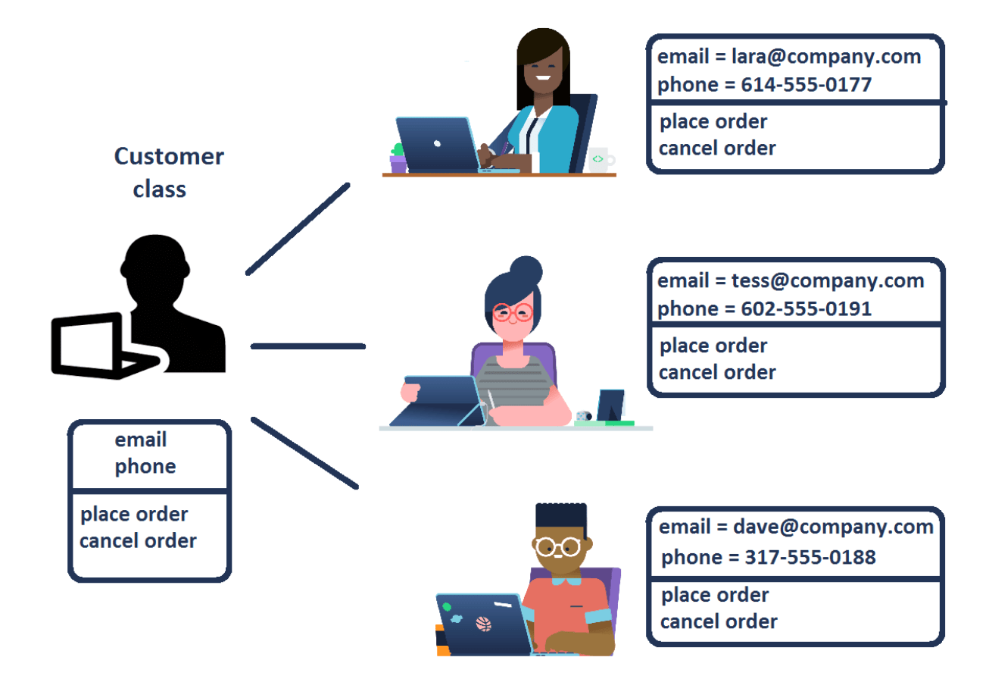
Think in Classes: Customer

Slide 8
Class Construction in Python: Car
# Illustration of Car Class Construction
class Car():
def __init__(self, colour, manufacturer, model):
self.colour = colour
self.manufacturer = manufacturer
self.model = model
def greet(self):
print("Congratulations you purchased, " + self.model + " " + self.manufacturer)

Slide 9
Class Construction in Python: Car
Class is Car()
Data are color, manufacturer & model
Method is greet()

Slide 10
Class Construction in Python: Customer
# Illustration of Customer Class Construction
class Customer():
def __init__(self, email, phone, place_order, cancel_order):
self.email = email
self.phone = phone
self.place_order = place_order
self.cancel_order = cancel_order
def greet(self):
print("Welcome!")
if self.place_order == "Y":
print("Your order is placed.")
else:
print("Your order is not placed.")
if self.cancel_order == "Y":
print("Your order is cancelled.")
else:
print("Your order is not cancelled.")

Slide 11

Object

Slide 12
Object
An instance of the defined class with actual values
Many instances of different values can be associated with a class
Each instance is independent
After creating objects through instantiation, the self parameters are usually not required

Slide 13
Attributes
Attributes as self parameters
Attributes without self
Illustration: count the number of customers in Customer() class
[Illustration code shown in the next page]

Slide 14
Attributes: Illustration
class Customer():
count_customers = 0
def __init__(self, email, phone, place_order, cancel_order):
self.email = email
self.phone = phone
self.place_order = place_order
self.cancel_order = cancel_order
Customer.count_customers += 1
def greet(self):
print("Welcome!")
if self.place_order == "Y":
print("Your order is placed.")
else:
print("Your order is not placed.")
if self.cancel_order == "Y":
print("Your order is cancelled.")
else:
print("Your order is not cancelled.")
def num_of_customers(self):
print("Current number of customers are :" +str(Customer.count_customers))

Slide 15
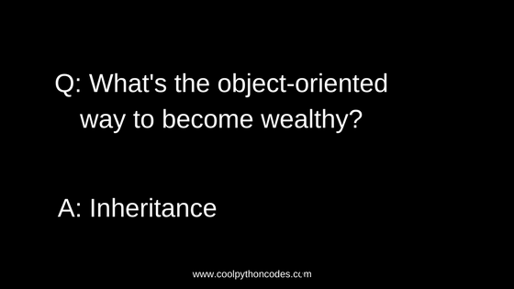
Inheritance

Slide 16
Inheritance
Used to make OOP code
Modular
Easy to use
Develop relationship between classes
Inherits from parent class or super class and create a child class
Parent class is generic type
Child class is special type
Construction of class for inheritance
Class Classname(superclass):
Code
The newly created child class can inherit all attributes and methods from super class

Slide 17
Inheritance
Inheriting and Method Overriding
When different attributes should be passed
Inheriting and Updating Attributes with Super
When an additional attirubute(s) is needed:
Instead of re-writing the whole class, a super method is used
Illustrations are provided on Github file: “Inheritance.ipynb”

Slide 18
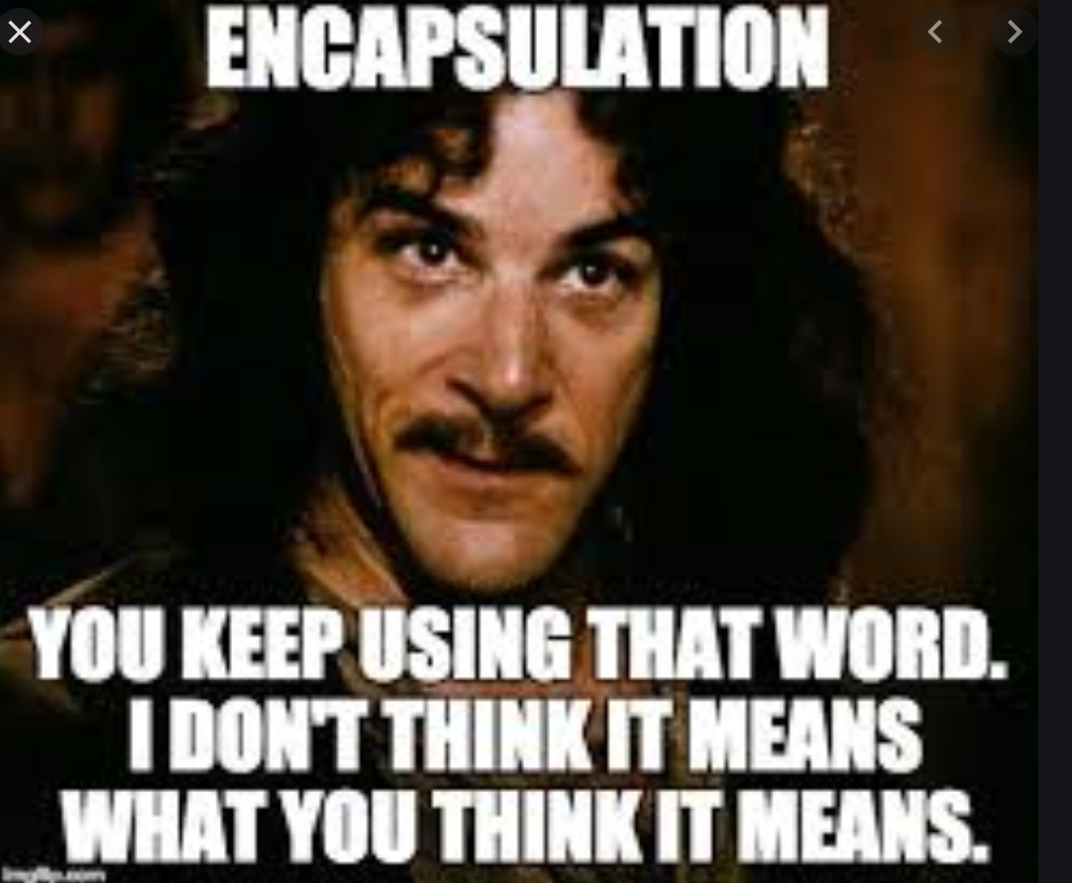
Encapsulation

Slide 19
Encapsulation
Used in OOP code
To hide private details of a class from other objects
The idea is to restrict access to attributes and methods in a class
Primarily hide complex code as well as prevent data from being changed accidentally
Python achieves encapsulation using
_
__
Illustration is provided in “Encapsulation.ipynb”
Say you want to protect the number of stocks purchased

Slide 20
Polymorphism
Used in OOP code
To use common operation in different formats
Illustration is provided in “Polymorphism.ipynb”

